Slide 1
RAILWAY TICKET SALES AND JOURNEY PERFORMANCE ANALYSIS
Business insights & Operational Performance Review
Ganiyu Rasheedat Oluwakemi
Data Analytic Intern
May 2026
Tool used: Power Bi

Slide 2
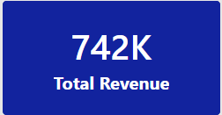
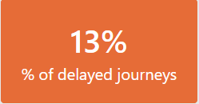
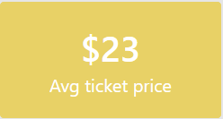
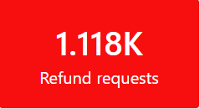
Business Overview & Key Metrics
The analysis focused on railway ticket sales, customer behavior, journey delays, refunds and operational performance to identify key business risks and growth opportunities.

Slide 3
Journey Delays & Operational Challenges
Insights
Delayed journeys significantly increased refund requests and cancellations.
The leading causes of delays were:
Signal failures
Staff shortage
Weather disruptions
13% of all journeys experienced delays.
Business Impact
Reduced customer satisfaction.
Increase in refund-related revenue losses.
Operational inefficiencies during peak periods.

Slide 4
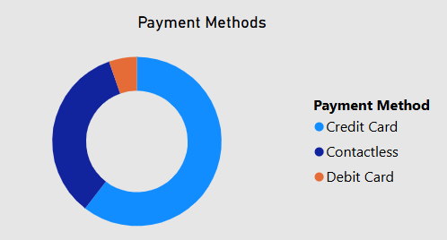
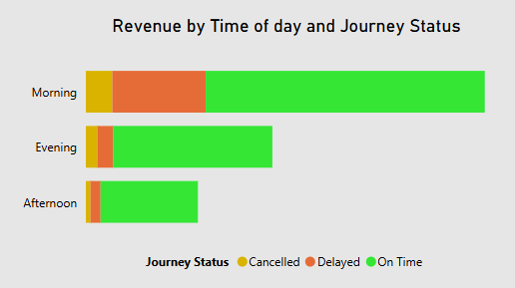
Revenue Drivers & Customer Behavior
Revenue Trends
Total revenue generated: 742K
Morning journeys generated the highest revenue (297K)
Evening journeys generated the second highest revenue (169K)
Customer Behavior
Credit card was the most used payment method.
Major stations with the highest journey traffics include:
Manchester Piccadilly Station
London Euston Station
Birmingham New Street Station
Liverpool Lime Street Station

Slide 5
Recommendations & Focus Areas
Improving delay management
Reduce signal-related disruptions
Deploying additional support staff for travel peak hours (mornings and evenings)
Expected outcome
Reduction in refund requests and cancellations due to delays.
Improved customer satisfaction.
2. Strengthening peak hour operations
Increased and continuous operational monitoring
Ensuring availability of enough support staff during peak periods.
Expected outcome
Protect and secure high revenue periods.
Improve service reliability

